Slide 1


MALLA REDDY COLLEGE OF ENGINEERING & TECHNOLOGY
DEPARTMENT OF INFORMATION TECHNOLOGY
IDENTIFYING RECYCLABLE MATERIALS FROM IMAGES
Batch-No:18
23N35A1214 – P.NAVEEN REDDY
23N35A1215 – R.SRIHARI
22N31A12H8 – T.SIDDHARTH REDDY
GUIDED BY: M.SAI KRISHNA MURTHY
ASSOCIATE PROFESSOR

Slide 2
Agenda
Abstract
Introduction
Literature Review
Software Requirement Specification
System Design
Code
Result
Conclusion

Slide 3
Abstract
The increasing importance of waste management and recycling has driven the need for efficient and automated systems to identify recyclable materials. This study explores the application of computer vision and deep learning techniques to classify recyclable items from images. Using convolutional neural networks (CNNs) and transfer learning with pre-trained models such as ResNet, EfficientNet, or YOLO, we develop a system capable of distinguishing between different categories of recyclable waste, including paper, plastic, glass, and metal. The proposed approach involves dataset collection, preprocessing, model training, and evaluation using metrics such as accuracy, precision, and recall. Experimental results demonstrate the effectiveness of deep learning in accurately identifying recyclable items, with potential applications in smart waste sorting systems, recycling facilities, and consumer-facing apps.

Slide 4
Introduction
Every day, people throw away a lot of trash, and not all of it is sorted properly. Many items that could be recycled end up in the wrong bin, which causes problems for recycling centers. One reason this happens is because people often don’t know what can and can’t be recycled. This project aims to solve that problem by using computer technology to recognize recyclable items With the help of machine learning and image recognition, we can teach a computer to look at a picture of trash and decide if it can be recycled. This can make recycling easier, reduce waste, and help protect the environment.

Slide 5
Literature Review
S.NO | NAME OF THE AUTHOR | TITLE OF THE PAPER | SOURCE | CITATION | METHODOLOGY | RESULTS | FUTURE ENCHANCMENT
01 | Mei Wang, Wenping Deng | Identification of recyclable materials using image processing. | arXiv Preprint, 2024 | arXiv 2024 | Developed custom CNN trained on labeled recyclable material images. | 90% accuracy in distinguishing recyclables like metal, plastic, glass in mixed-waste scenarios. | Expand to more materials; real-time sorting optimization.

Slide 6
S.NO | NAME OF THE AUTHOR | TITLE OF THE PAPER | SOURCE | CITATION | METHODOLOGY | RESULTS | FUTURE ENCHANCMENT
02 03 | Jiawei Chen, Rui Li, Xinyu Zhang Raymond hong, Wen Jie Zhao | Multi-Class Image Classification Using Transfer Learning for Recycling Automation Automated Product Tagging Using Deep Learning for Image Based Recognition. | Elsevier – Expert Systems with Applications, 2024 Science Direct – Journal of Image Representation, 2024 | Elsevier 2024 Science Direct 2024 | Used transfer learning for classifying recycling images with limited data. Utilized deep CNNs for product image classification based on shape, color, and texture. | Achieved high accuracy with fewer training images High efficiency in recognizing diverse and visually similar products | Improve handling of ambiguous/ mixed waste. integrate image and text data.

Slide 7
S.NO | NAME OF THE AUTHOR | TITLE OF THE PAPER | SOURCE | CITATION | METHODOLOGY | RESULTS | FUTURE ENCHANCMENT
04 | Ran Tian, Zhihe Wang | AI-Powered Visual Recognition for Smart City Systems | IEEE Xplore – IEEE Internet of Things Journal, 2024 | IEEE Xplore 2024 | Applied ML to detect urban elements (e.g., bins, waste) via city-wide camera networks | Robust detection under varying lighting/angles. | Improve extreme condition performance; support recyclability classification

Slide 8
Software Requirements Specification
SOFTWARE REQUIREMENTS:
Operating System : Windows 11
IDE : VS Code Studio
Languages : Python 3.10
Frameworks : Tensor flow
Libraries : Pandas
Database : Superbase

Slide 9
HARDWARE REQUIREMENTS:
Processor : Intel core i5
Ram : 8 GB (16 GB Recommended)
Hard disk : 512 GB

Slide 10
FUNCTIONAL REQUIREMENTS:
Image Upload:
The system should allow users to upload or capture an image of a waste item.
Image Preprocessing:
The system should preprocess the uploaded image (resize, normalize, etc.) to
prepare it for classification.
Classification:
The system should classify the image into categories such as plastic, metal, glass,
paper using a trained CNN model.
Confidence Score:
The system must display a confidence percentage along with the classification
result (e.g., Plastic – 92%).
Result Display:
The system should show the classification result clearly in the interface.

Slide 11
NON-FUNCTIONAL REQUIREMENTS:
Accuracy:
The model should achieve high accuracy (e.g., above 85%) in classifying recyclable items.
Latency:
The system should respond with classification results in under 2–3 seconds.
Usability:
The interface should be simple and user-friendly, suitable for mobile and desktop.
Scalability:
The system should be able to handle multiple requests simultaneously without crashing.
Security:
The system must not store sensitive user data, and any uploaded image should be
securely handled.

Slide 12
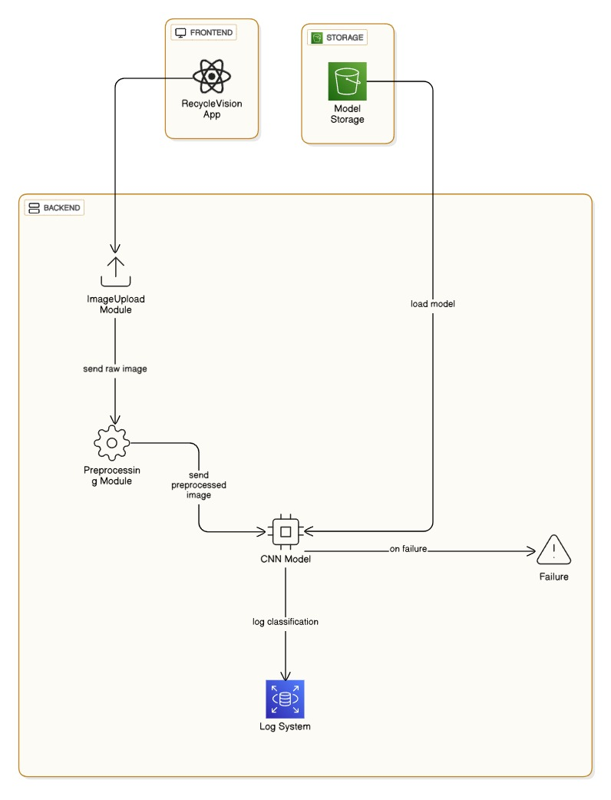
Architecture

Slide 13
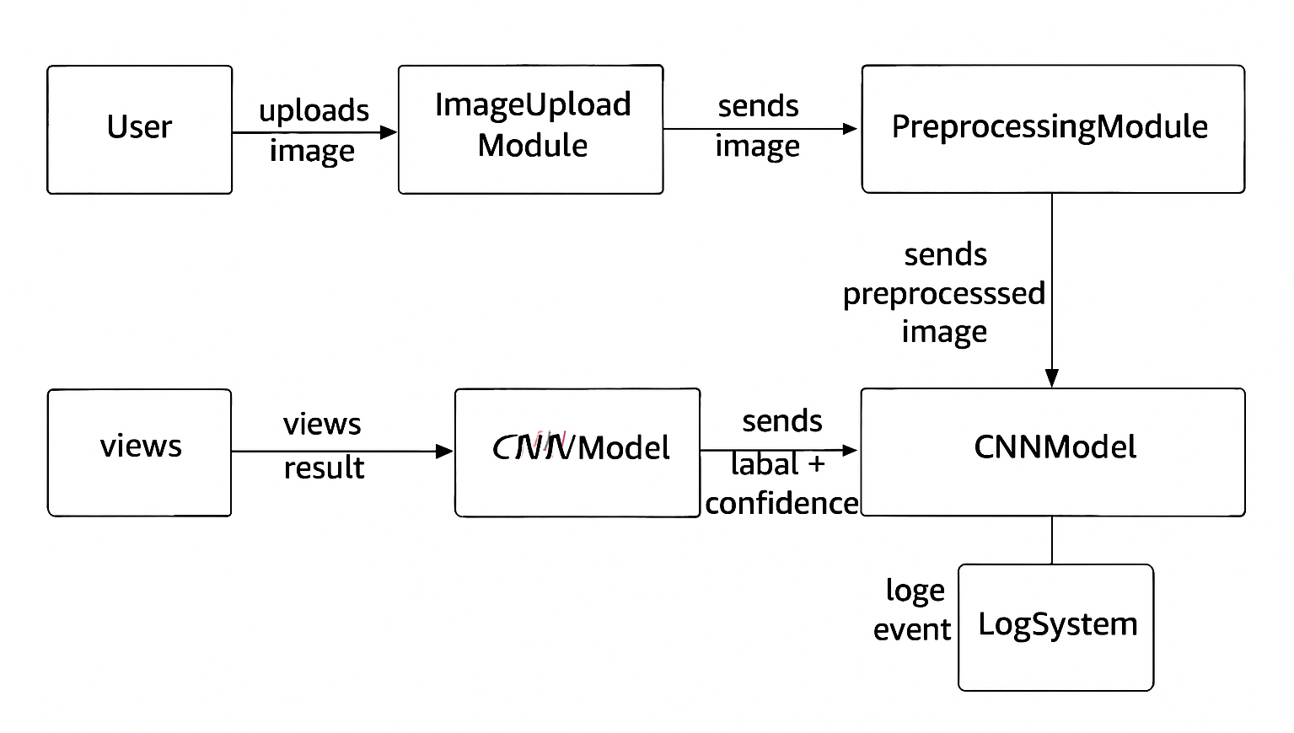
UML Diagrams
Class Diagram:

Slide 14
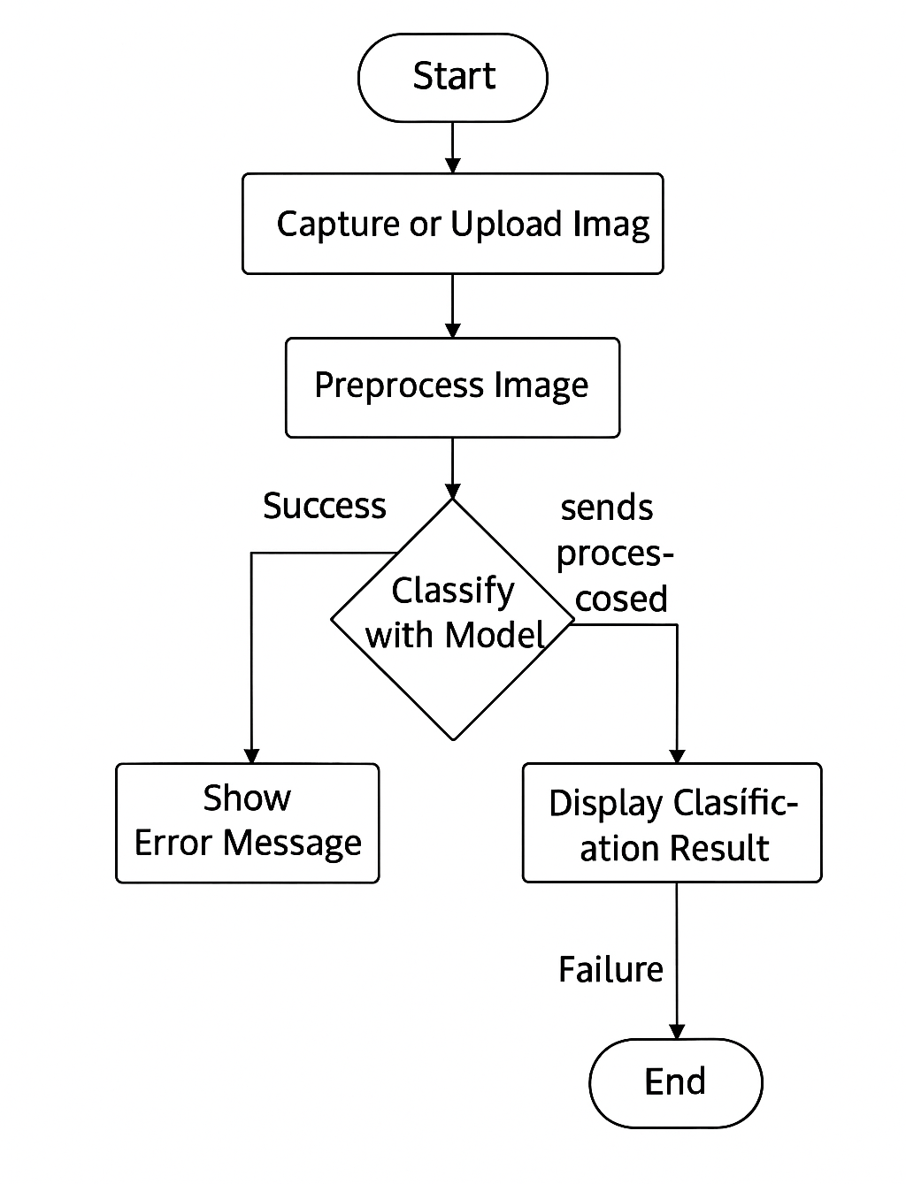
Activity Diagram:

Slide 15
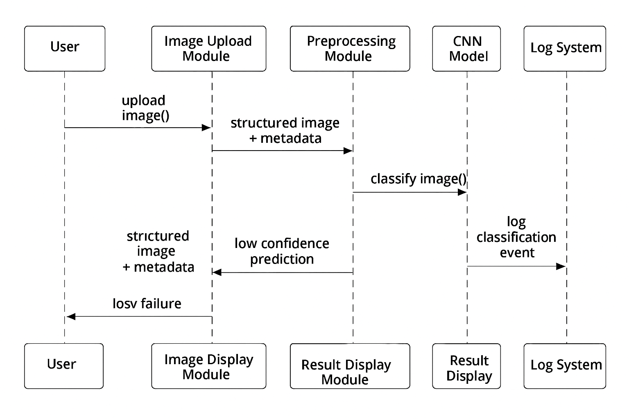
Sequence Diagram:

Slide 16

Code :

Slide 17
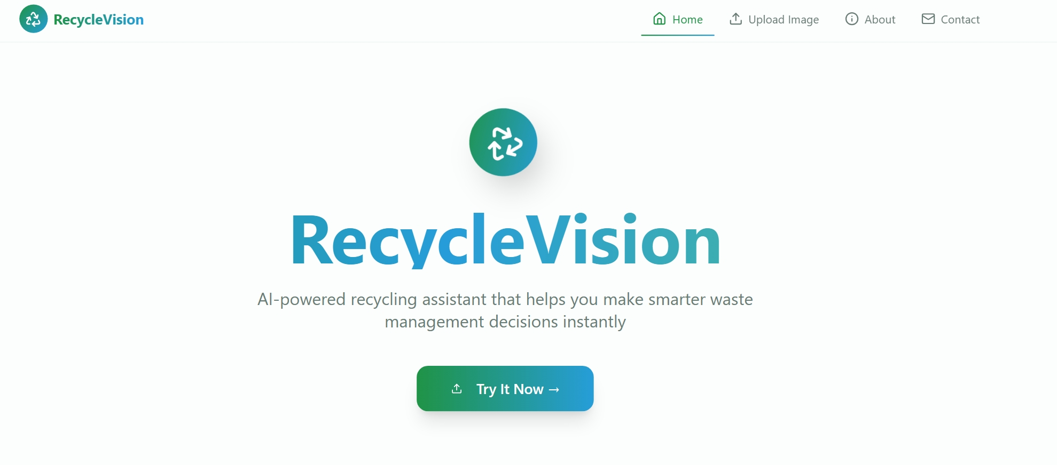
Result :

Slide 18
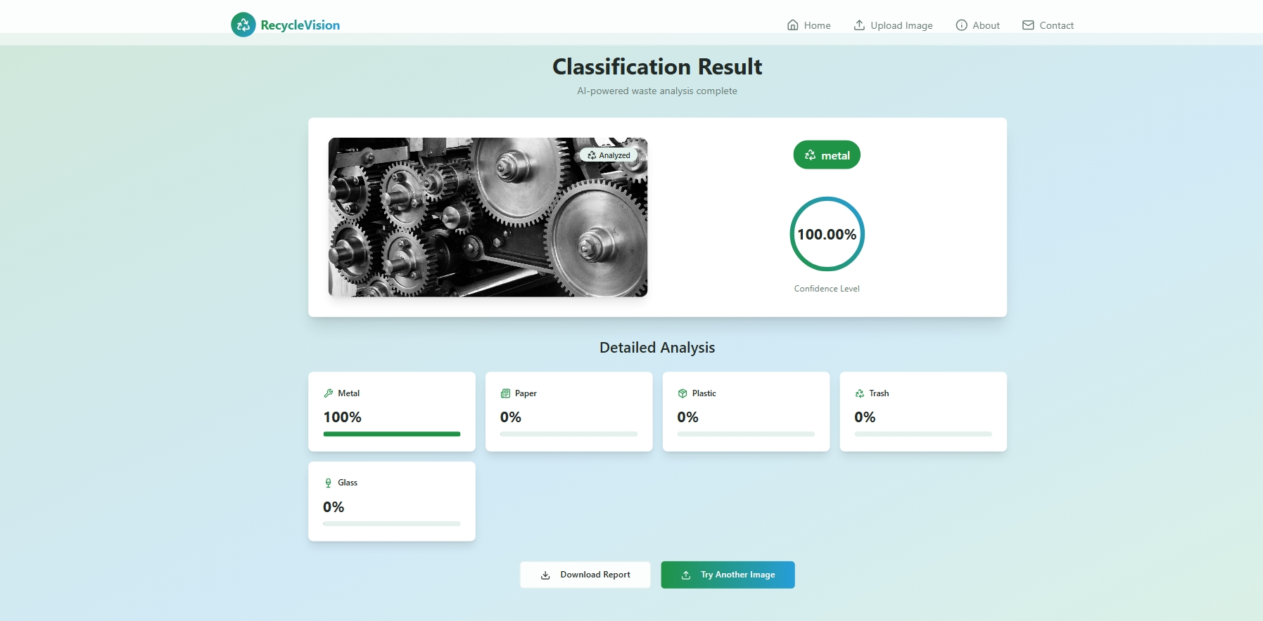

Slide 19
Conclusion :
This project helps to recognize different types of waste like plastic, paper, glass, and metal just by looking at pictures. It uses artificial intelligence to tell which items can be recycled. This makes waste sorting easier, saves time, and helps protect the environment.In the future, we can improve the system by adding more images and making it more accurate, so it can be used in real-life tools like smart dustbins or mobile apps.

